Slide 1

ENGINEERING
ECONOMICS AND MANAGEMENT
TOPIC: RURAL MARKETING
PREPARED BY: S.Y I.T-1
PATEL SAKSHI. 3rd Sem
170413116016 Batch-D
(217BEITV020)

Slide 2
RURAL MARKETING:
RURAL MARKETING
MARKETING PROCESS IN RURAL MARKETING
EVOLUTION OF RURAL MARKETING
RURAL MARKETING IN INDIAN ECONOMY
DIFFERENCE BETWEEN RURAL AND URBAN MARKETING
VALUE ADDITION TO RURAL MARKETING
COMPANIES INVOLVE IN RURAL MARKETING
CASE STUDY
CONCLUSION

Slide 3
INTRODUCTION TO MARKETING
“MARKETING is the activity, set of institutions , and processes for creating, communicating, delivering, and exchanging offerings that have value for customers, clients, partners and society at large.”
Identifying the needs of customers and potential customers, providing products/services that satisfy their needs, and developing efficient processes or systems to deliver your product/service to the market when, where, and how consumers want it.

Slide 4
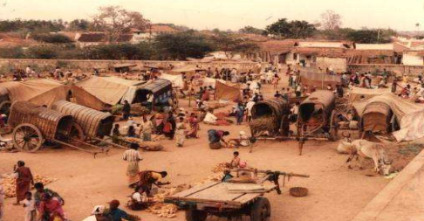
RURAL MARKETING

Slide 5
Rural Marketing: Rural marketing is now a two-way marketing process. There is inflow of products into rural markets for production or consumption and there is also outflow of products to urban areas. The urban to rural flow consists of agricultural inputs, fast-moving consumer goods (FMCG) such as soaps, detergents, cosmetics, textiles, and so on. The rural to urban flow consists of agricultural produce such as rice, wheat, sugar, and cotton. There is also a movement of rural products within rural areas for consumption.

Slide 6
MARKETING PROCESS IN RURAL MARKETING
URBAN TO RURAL:
Major part of rural marketing. Includes transactions of urban marketers who sell their goods and services in rural areas pesticides, fertilizers, FMCG products, tractors, bicycles, consumer durables, etc.
RURAL TO URBAN:
Basically falls under agricultural marketing. A rural producer seeks to sell his produce in urban market like seeds, fruits and vegetables, forest produce, spices, milk and related products, etc.

Slide 7
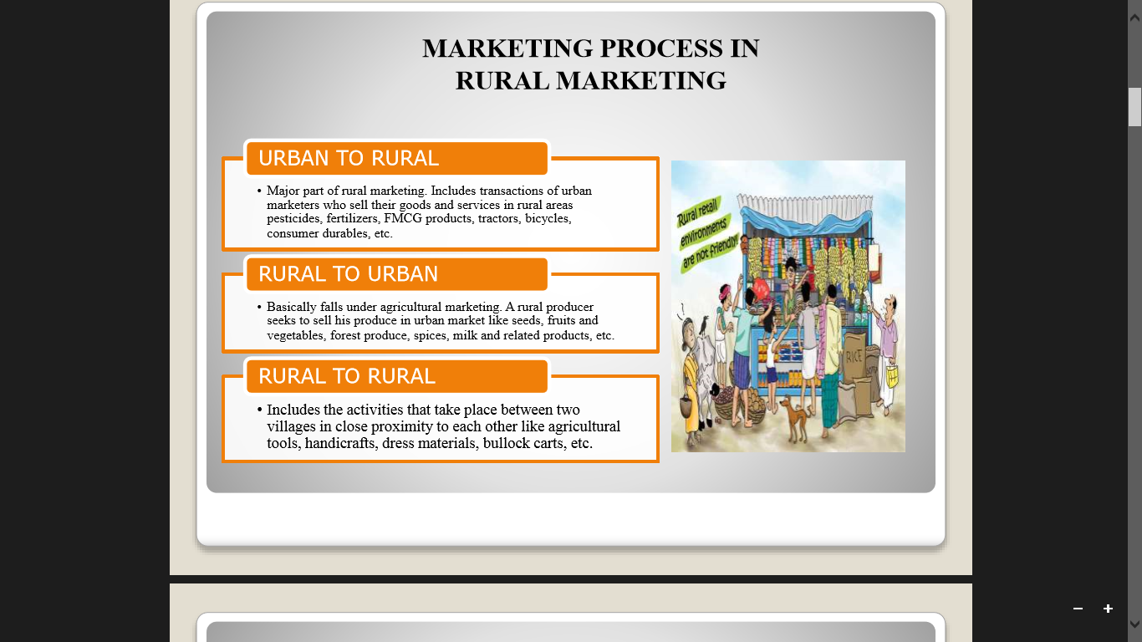
RURAL TO RURAL:
Includes the activities that take place between two villages in close proximity to each other like agricultural tools, handicrafts, dress materials, bullock carts, etc.

Slide 8
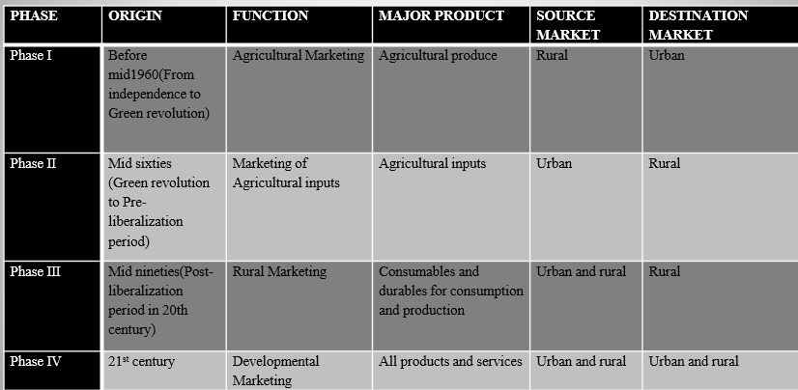
EVOLUTION OF RURAL MARKETING

Slide 9
RURAL MARKETING IN INDIAN ECONOMY
The concept of Rural Marketing in Indian Economy has always played an influential role in the lives of people. In India, leaving out a few metropolitan cities, all the districts and industrial townships are connected with rural markets. The rural market in India is not a separate entity in itself and it is highly influenced by the sociological and behavioural factors operating in the country. The rural population in India accounts for around 627 million, which is exactly 74.3 percent of the total population. The rural market in India brings in bigger revenues in the country, as the rural regions comprise of the maximum consumers in this country. The rural market in Indian economy generates almost more than half of the country's income.

Slide 10
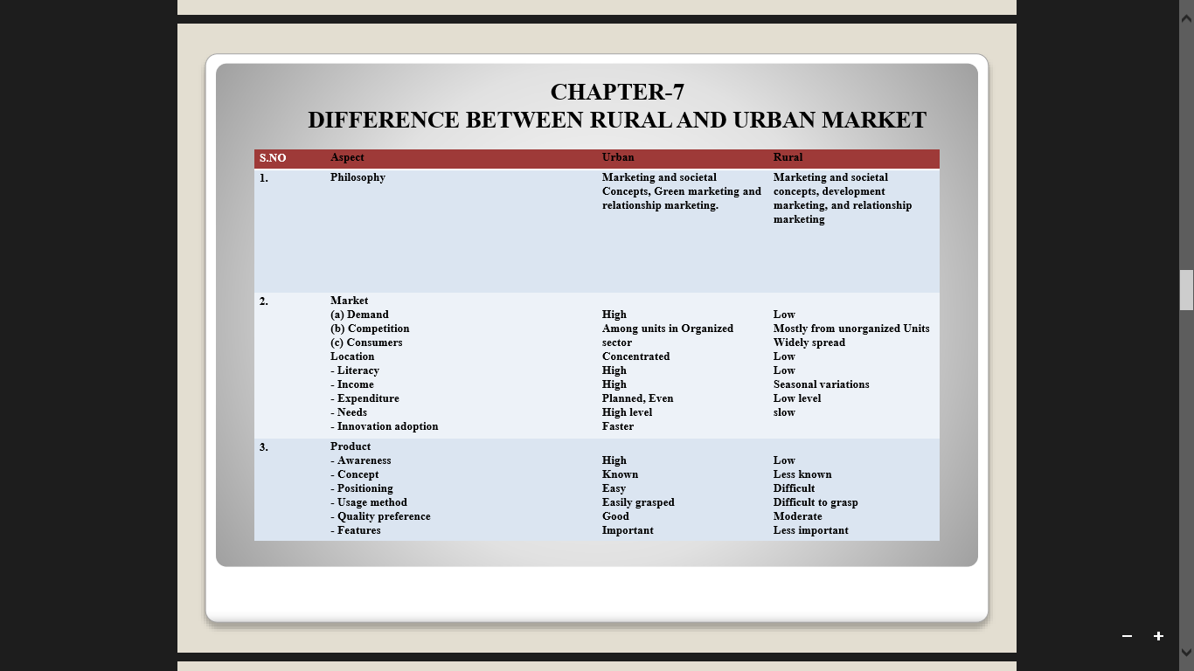
DIFFERENCE BETWEEN RURAL AND URBAN MARKET

Slide 11
VALUE ADDITION TO RURAL MARKETING
After understanding the differences between rural and urban market, it is essential to understand the needs of rural people and redesign marketing plan to make it more rural specific. The following points must be strongly considered:
1. Know the importance of women.
2. Offer small unit packing. JK Dairy Top sachets revolutionized the market.
3. Reinforce product quality through service initiatives. Hero Honda has established mobile service centers to take care of rural customers.

Slide 12
4. Establish one-to-one communication channels. Reckit & Colman uses NGOs in rural area to educate customers about product benefits.
5. Use local idioms to convey your message in a meaningful context.
6. Core values of brand must strike the consumer.
7. Go rural and be rural.
8. Groom a separate set of professionals more conversant with the rural markets.

Slide 13
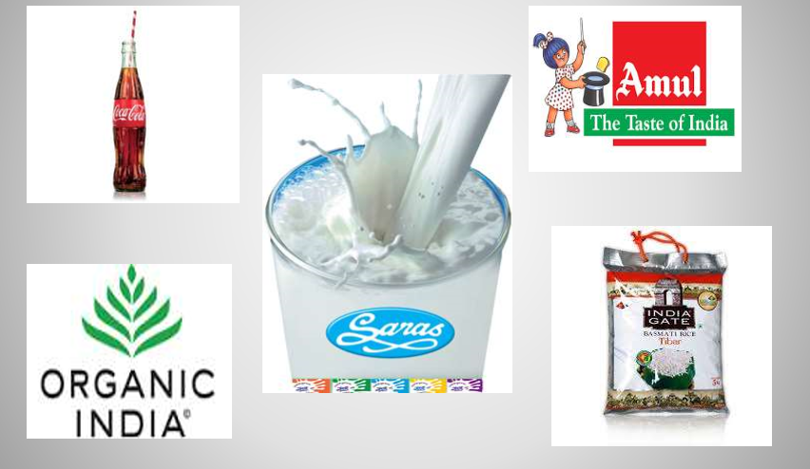
COMPANIES INVOLVE IN RURAL MARKETING

Slide 14
CASE STUDY ON RURAL MARKETING

Slide 15
READY TO RULE RURAL INDIA
Rural India constitutes ‘the heart of India’, generating more than half the national income. According to the National Council of Applied Economic Research (NCAER), with about 74% of its population living in its villages. India has perhaps the largest potential rural market in the world.
A potential of 742 million rural consumers live in 6,38365 villages across India. Rising incomes, improving infrastructure, and favourable government policies offer huge potential for rural marketing.
“If you see a woman in a village milking a cow, do you see an opportunity? but that is exactly where Dr. Varghese Kurian saw an opportunity and it gave birth to one of the most successful organizations in India-Amul .”

Slide 16
The need to look at rural markets:
The “Green Revolution” has in turn, brought a socioeconomic revolution in Indian villages. On account of the green revolution the rural areas are consuming a large quantity of not just the essential commodities but premium products as well. The younger generation in rural areas is now spending more on personal care and grooming products.

Slide 17
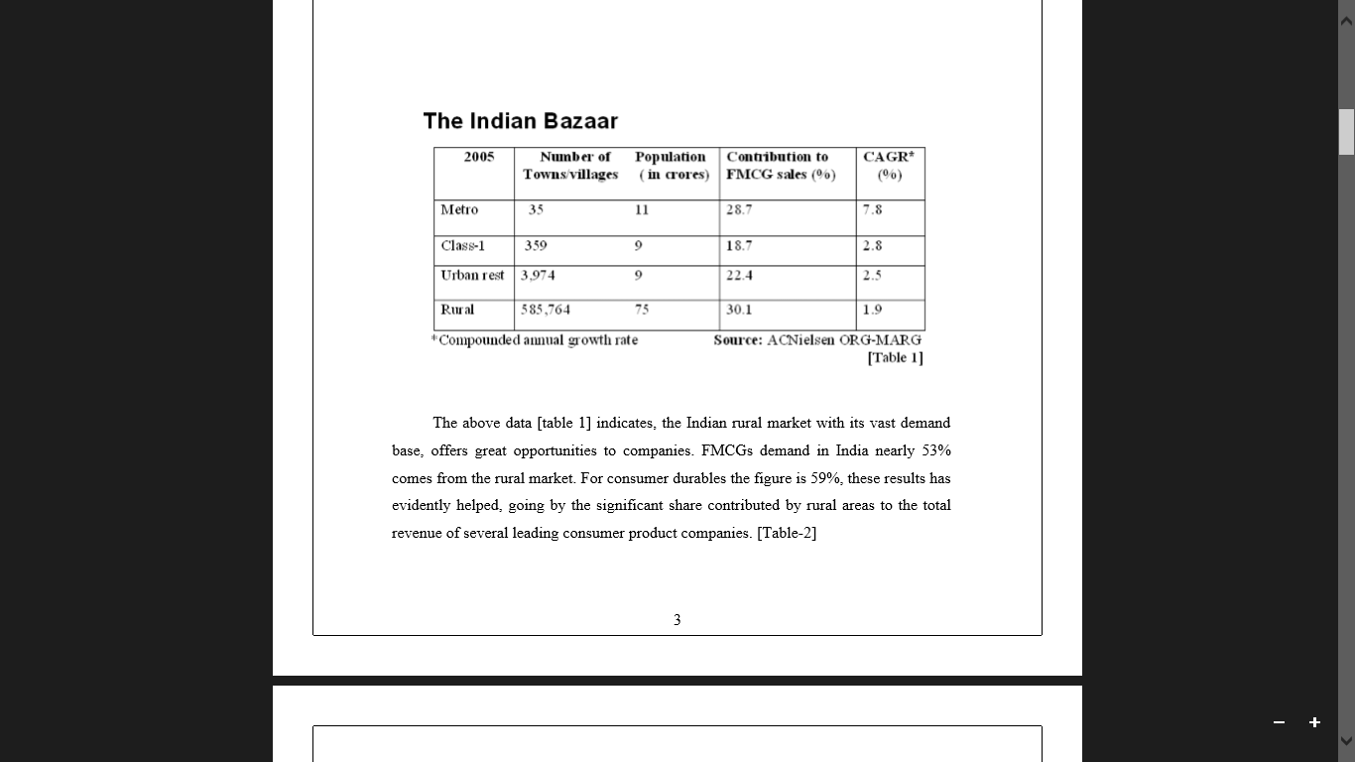

Slide 18
The above data [table 1] indicates, the Indian rural market with its vast demand base, offers great opportunities to companies. FMCGs demand in India nearly 53% comes from the rural market. For consumer durables the figure is 59%, these results has evidently helped, going by the significant share contributed by rural areas to the total revenue of several leading consumer product companies. [Table-2]

Slide 19
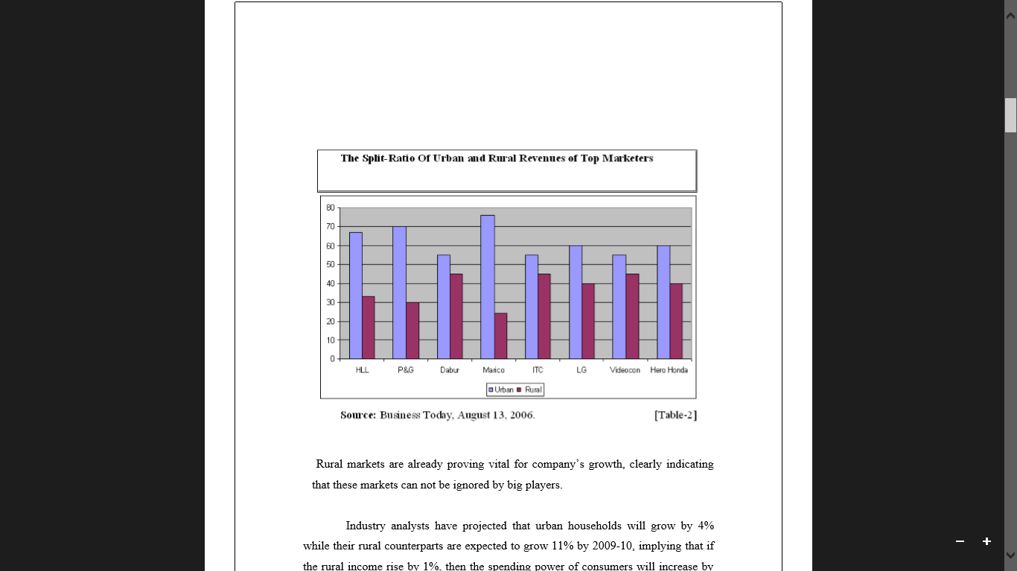
Rural markets are already proving vital for company’s growth, clearly indicating that these markets can not be ignored by big players.
Industry analysts have projected that urban households will grow by 4% while their rural counterparts are expected to grow 11% by 2009-10, implying that if the rural income rise by 1%, then the spending power of consumers will increase by about Rs.10,000cr.
According to FICCI, by the end of 2025, rural consumption is expected to nearly three times of what it is today.
There is no denying the fact that Indian market is the fastest growing market in the world and the fact is that about 60% of the market considered rural market is yet to turn into a real market.

Slide 20
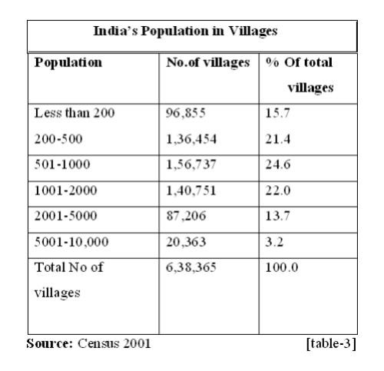
What is Rural Market?
According to the Census of India 2001, there are more than 4,000 towns in the country. It has classified them into six categories, class-I towns with one lake and above population , Class-II towns with 50,000-99,999 population, Class-III towns with 20,000-50,000 population and Class-IV towns with 10,000-19,999 population.
It is mainly Hindustan Unilever and ITC, most FMCG and consumer durable companies, define Class-II and III towns that are rural.[table-3]

Slide 21
Rural Marketing Challenges:
Poor Infrastructure
Non-availability of shops
High levels of poverty
Unemployment
Poor literacy rate
Poor media penetration
Sceptical customers (less use new brand )
Rigid social customs

Slide 22
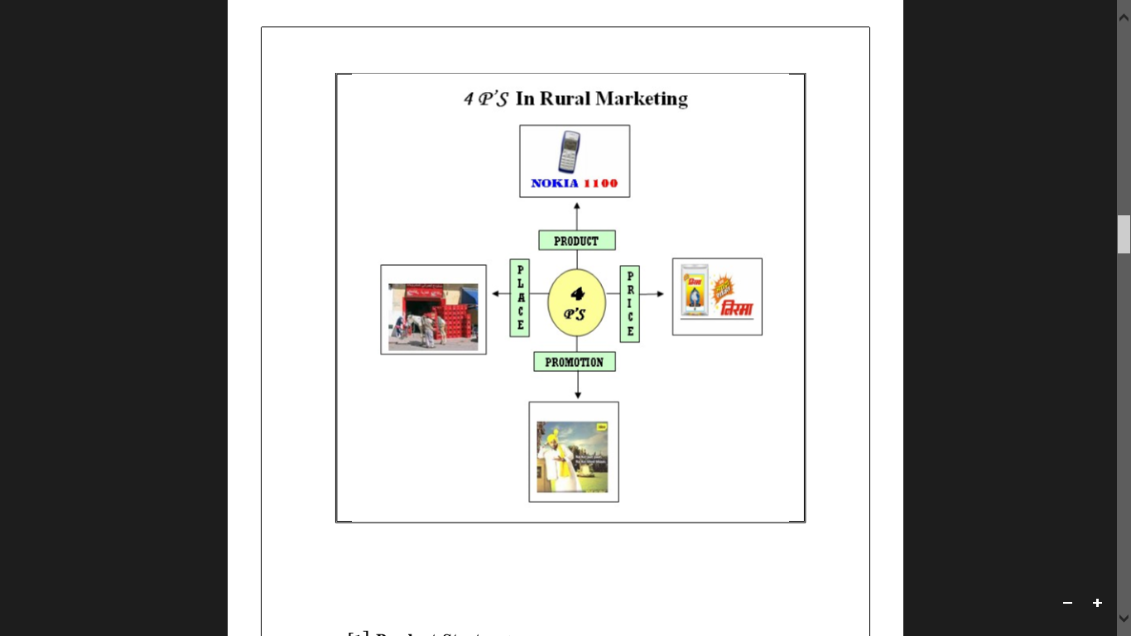
Rural Marketing Strategies:
Rural marketing concept is a customer-centered ‘sence and respond’ philosophy.
The following section deals with how MNC’s and local companies have successfully established themselves in the rural market.

Slide 23
[1] : PRODUCT STRATEGY
The rural consumer is very conscious about getting ‘value for money’. Low price, high quality and multiple uses is basic principles rural product design.
CASE 1: Nokia 1100
Nokia 1100 has so penetrated in to the rural market.
Nokia had to stop its production of 1100 because as its own product has become its toughest competitor.
Nokia’s low-end cell phones are used as radios, alarm - clocks and flash lights by the rural customers.
Strategy: “digital convergence at the bottom of market”.

Slide 24
Case 2 : LG sampoorna TV
LG Electronics launched a customized TV sampoorna’.
A more important aspect of customization is to make TV set which can appeal to local needs, it facilitated on screen display in vernacular language like Hindi, Tamil and Bengali. selling 1,00,000 sets in the very first year.
Strategy: “thinking locally, succeeding globally”

Slide 25
Case 3: HUL pure-it [a water purifier brand]
HUL launched a innovative product ‘pure-it’ a water Purifier brand.
Pure-it is available at economical price for the rural consumer as there is no clean drinking water in villages.
Strategy: “Corporate social responsibility means come up with business models to cater to the BOP”

Slide 26
Case 4: TATA Nano
Tata Motors launched ultra low cost Nano. Nano is a low-end ‘rural car’, hence its creates a new segment of people of buying car.
It is a victory for all those who have been advocating making available cheaper products for customers at the BOP.
Strategy: “we needed to create a safer journey of transporting a family”

Slide 27
SUGGESTIONS:
Innovative product designs and packaging.
Avoid the marketing myopia, which means the costumer will have the same need but will want the new product.
Application of value engineering, which means costly metal being replaced by cheaper reinforced plastic. This technique does not sacrifice the functional efficiency of a product but lower the product price.
Using Chinese product design strategy and raw material.
Be care full on product duplicates and using security features.

Slide 28
[2] : PRICE STRATEGY
Rural markets are low price high volume growth markets. The rural markets being intensely price-sensitive in comparison to urban markets, reaching at a lower cost is a major challenge.
Case 1: Nirma
Nirma’s yellow detergent powder- a mass- market Phenomenon. Nirma’s low price policy has penetrated into the deepest rural markets in India.
Strategy: “value- for- money”

Slide 29
Case 2: Cavinkare’s Chik shampoo
Cavinkare launched Chik in 50 paisa sachets. Cavinkare targeted rural and small town customers who used soaps to wash their hair. it became the market leader in the rural markets with over 50% market share. It create a ‘sachet revolution’.
Strategy: “low unit price packs.” (LUP)

Slide 30
Case 3: Mc Donald’s
The Indian customers seek high value for every rupee spent . so Mc Donald’s has been highlighting the “Happy price menu- Rs. 20” to shackle entry barriers appeal to Indian customers.
Strategy: “highlighting the value being delivered for a small price”.

Slide 31
Case 4: Nestlé’s Maggi
Nestlé's rural initiatives have largely been based on Price-led initiatives. Brand such as Maggi noodles are priced at Rs.5.
It helped Nestle in making in roads in to rural market.
Strategy: “small pack - lower price”

Slide 32
SUGGESTIONS:
Use backward and forward integration.
Using value-based pricing strategy . That means fixing of price, starting with customer and end with product.
Use psychological tricky pricing strategies. That means method of odd number pricing etc.
Effective total quality management is helps to low price high quality product.
Companies should focus on creative solutions and product engineering to reduce their cost.
Second, the company can design basic models minus frills to save cost.

Slide 33
CONCLUSION
A silent revolution is sweeping the Indian countryside. The marketing battle fields has shifted from the cities to the villages but in this battle both consumers and companies are winners, it is a win-win situation. ‘GO RURAL’ seems to be the latest slogan. Go and meet the villagers and ask them what they want. Create the products and services that is relevant to their needs and it is the high time for the companies to focus, luxuries as necessities for the Indian rural customers.

Slide 34
THANK YOU

